Slide 1
AWS VPC
CS516 – Cloud Computing
Computer Science Department
Maharishi International University

Slide 2

Maharishi International University - Fairfield, Iowa
All rights reserved. No part of this slide presentation may be reproduced or utilized in any form or by any means, electronic or mechanical, including photocopying or recording, or by any information storage and retrieval system, without permission in writing from Maharishi International University.

Slide 3
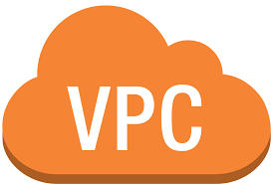
Content
AWS Global Infrastructure
VPC
Internet Gateways (IGW)
Route Tables (RT)
CIDR & Subnets
Network Access Control Lists (NACL)
NAT gateway

Slide 4
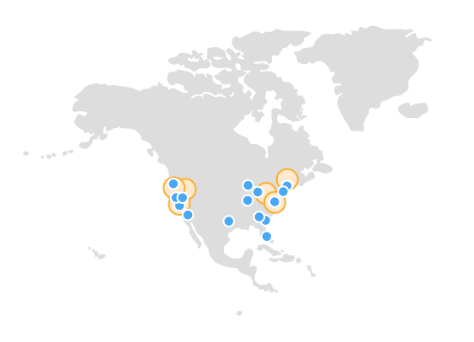
AWS Global Infrastructure
Regions - A physical location around the world where AWS clusters data centers. Usually comprised of multiple AZ.
Availability Zones - Geographical isolated zones within a region, one or more physical data centers.
Data Centers - Where the physical hardware that runs AWS services is located.
Read More about: AWS Global Infrastructure

Slide 5

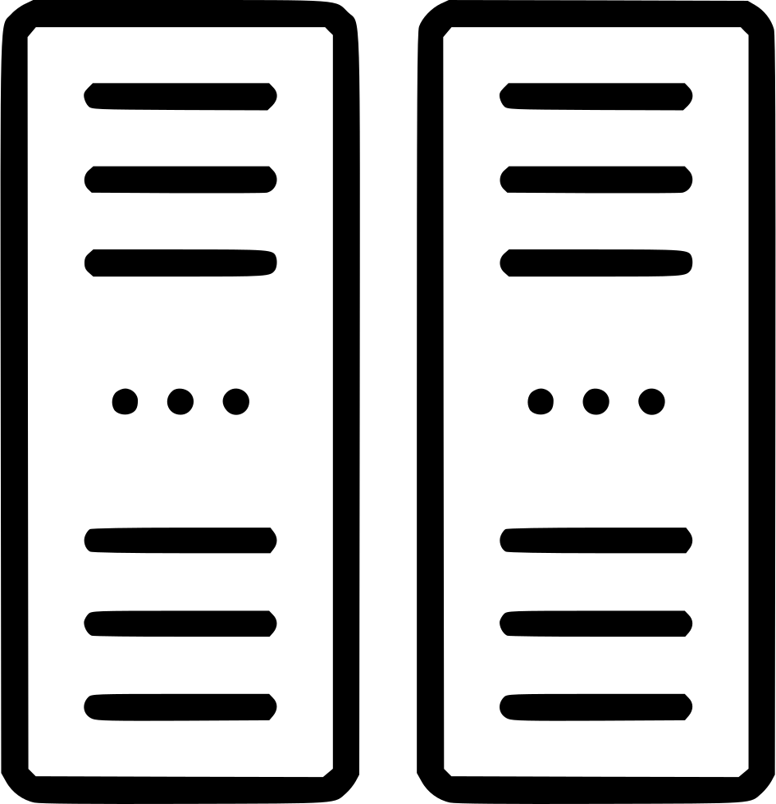
AWS Region/AZ
Each Region has multiple, isolated locations known as Availability Zones.
High Availability is creating an architecture in such a way that the system is always available (or has the least amount of downtime as possible).
Fault Tolerant is the ability of your system to withstand failures in one or more of its components and still remain available.
Availability Zones provide redundancy for AWS resources in that region, highly available, fault tolerant, and more scalability.
Low latency, high-bandwidth network is sufficient to accomplish synchronous replication between AZs. All traffic is encrypted.
Region
AZ #1
AZ #2
AZ #3
Read More about: Regions and Zones
Notes:
Different regions have different AWS services.
.
When you launch an instance, you can select an Availability Zone or let us choose one for you. If you distribute your instances across multiple Availability Zones and one instance fails, you can design your application so that an instance in another Availability Zone can handle requests.
You can also use Elastic IP addresses to mask the failure of an instance in one Availability Zone by rapidly remapping the address to an instance in another Availability Zone. For more information, see Elastic IP addresses.

Slide 6
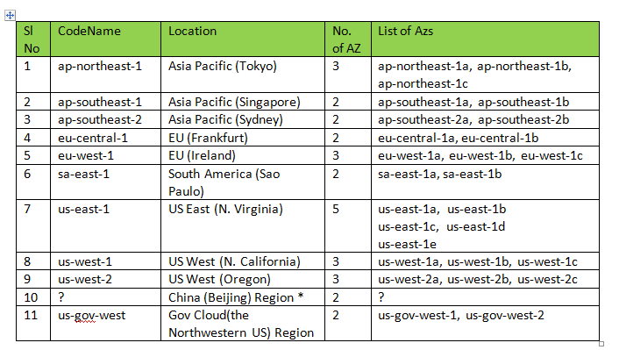
Regions and AZs
https://blog.sysfore.com/

Slide 7
Virtual Private Cloud (VPC)
Amazon Virtual Private Cloud is an isolated virtual network where your AWS resources run. You have complete control over your virtual networking environment, including selection of your own IP address range, creation of subnets and configuration of route tables and network gateways.
In a private (secure) sub-section of VPC, you can place AWS resources, like back-end servers and databases.
VPC is a regional service and is associated to a single region like most of other AWS services. You cannot span a VPC across regions. If you work on a global application, you deploy that in multiple regions.

Slide 8
Default VPC
When you create an AWS account a default VPC is created for you. It includes the standard components that are needed to make it functional:
Internet Gateway (IGW)
A Route table (with predefined routes to the default subnets)
A Network Access Control List - NACL (with predefined rules for access)
Subnets to provision AWS resources (such as EC2 instances)
You can select your own IP address range, create subnets and configure route tables and network gateways.

Slide 9
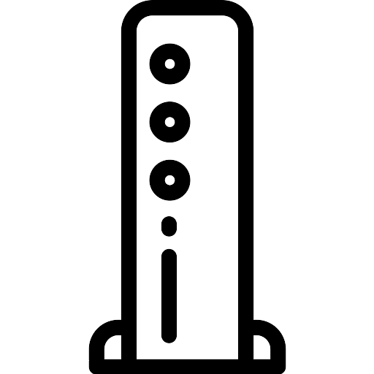
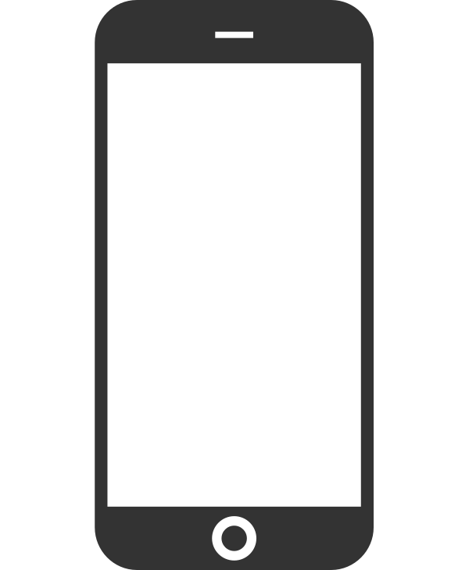
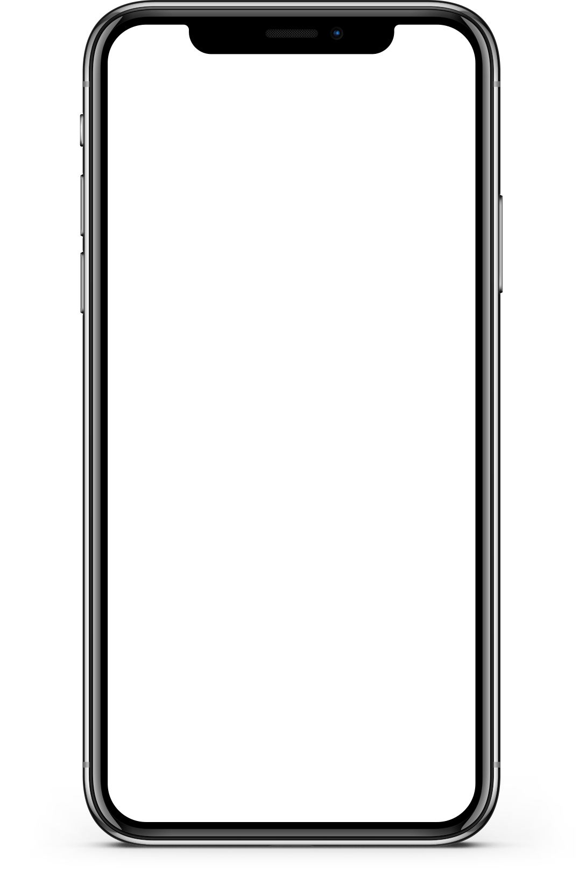
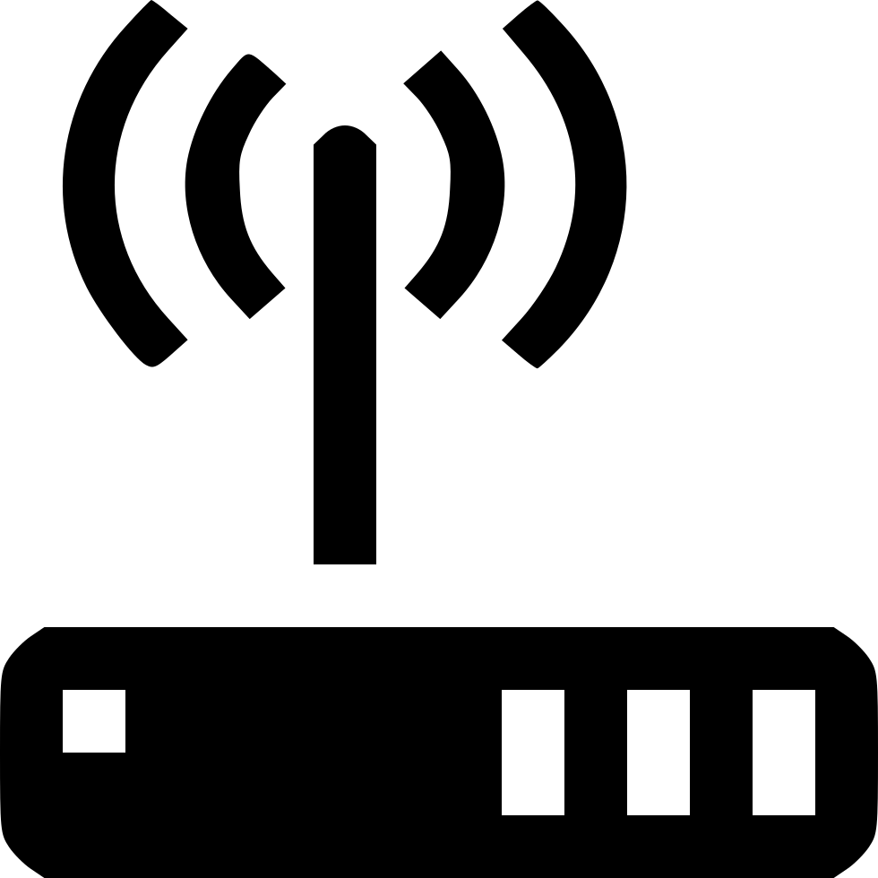


Your Home Network
Internet
Cable/DSL/Fiber Modem
Router / Switch
Firewall
Local Network

Slide 10
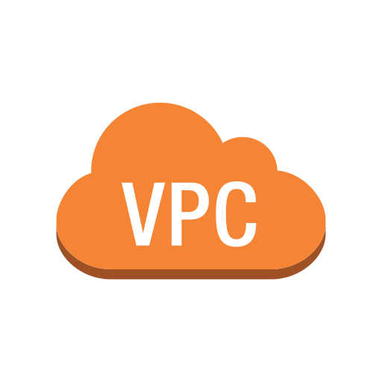
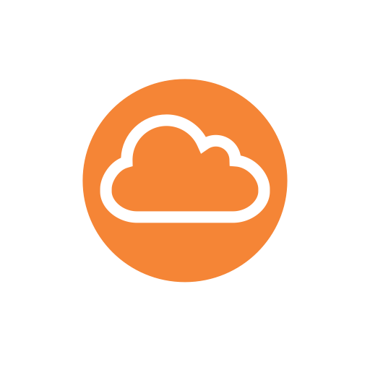
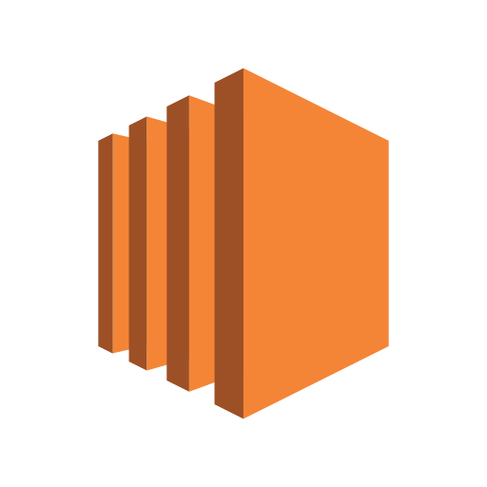
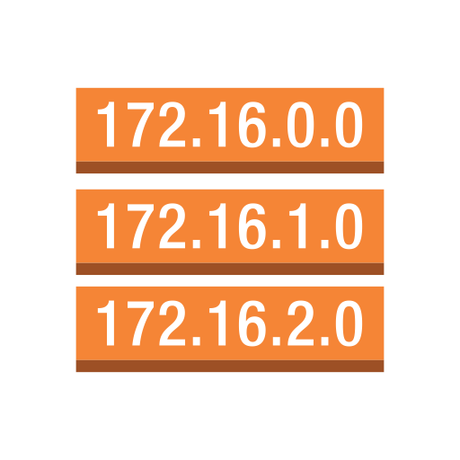

Internet Gateway - IGW
Network Access Control List - NACL
EC2
EC2
Route Table
Subnet 1 (public)
RDS
Subnet 2 (private)
Availability Zone 1
Availability Zone 2

Slide 11
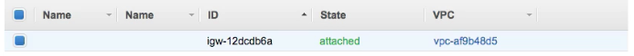
Internet Gateways - IGW
A combination of hardware and software that provides your private network with a route to the Internet.
One IP for all resources in your network (VPC).
A horizontally scaled redundant and highly available VPC component that allows communication between instances in your VPC and the Internet.
Your default VPC already has an IGW attached.
Only 1 IGW can be attached to a VPC at a time.
An IGW cannot be detached from a VPC while there are active AWS resources in the VPC.
Read more about Internet Gateways

Slide 12
Route Tables
A route table contains a set of rules, called routes, that are used to determine where network traffic is directed.
To define access between subnets, we use Route Tables
To define access to the internet, we use Route Tables
Read more about Route Tables
Notes:
Traffic cop: Should this stays in the VPC or travels out through the IGW.
To define access between subnets, we use Route Tables

Slide 13

Route Tables
Your default VPC already has a main route table.
Unlike IGW, you can have multiple active route tables in a VPC.
You cannot delete a route table if it has dependencies (associated subnets)
Any subnet associated with this RT will be public and have access to the internet
Notes:
Traffic cop: Should this stays in the VPC or travels out through the IGW.
To define access between subnets, we use Route Tables

Slide 14

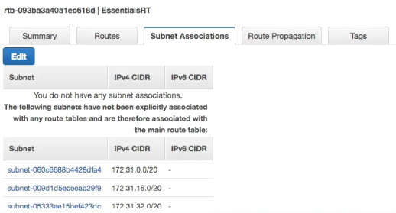
Route Tables
All subnets are implicitly associated with the Main RT.

Slide 15
Classless Inter-Domain Routing - CIDR
CIDR is a method for allocating IP addresses within a network.
CIDR IP addresses are composed of two sets of numbers:
The network address is written as a prefix.
The suffix which indicates how many bits are in the entire address.
For example: 10.0.0.0/24
CIDR to IPv4 Conversion: https://www.ipaddressguide.com/cidr
Notes:
a CIDR block of 192.0.128.0/21 . What this means is that the first 21 bits of the 32 bits that form the IP address are part of the network. The remaining bits (11 ) are for the IP addresses in the VPC.

Slide 16
CIDR ranges for the private network
10.0.0.0/8 | 10.0.0.0–10.255.255.255 | 16777216
172.16.0.0/12 | 172.16.0.0–172.31.255.255 | 1048576
192.168.0.0/16 | 192.168.0.0–192.168.255.255 | 65536
100.64.0.0/10 | 100.64.0.0–100.127.255.255 | 4194304
198.18.0.0/15 | 198.18.0.0–198.19.255.255 | 131072
192.0.0.0/24 | 192.0.0.0–192.0.0.255 | 256
Notes:
a CIDR block of 192.0.128.0/21 . What this means is that the first 21 bits of the 32 bits that form the IP address are part of the network. The remaining bits (11 ) are for the IP addresses in the VPC.

Slide 17
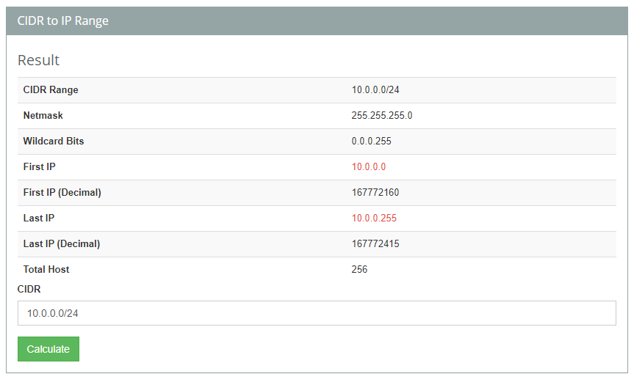
Sample CIDR
Notes:
a CIDR block of 192.0.128.0/21 . What this means is that the first 21 bits of the 32 bits that form the IP address are part of the network. The remaining bits (11 ) are for the IP addresses in the VPC.

Slide 18
Subnets
A subnet is a sub-section of a network. Generally, it includes all the computers in a specific location like zip code for addressing houses.
After creating a VPC, you can add one or more subnets in each AZ. Each subnet must reside entirely within one AZ and cannot span zones.
Subnets are expressed in CIDR.
Read more about Subnets
Notes:
Circling back to the home network analogy, if you think about your ISP being a network, then your home network can be considered a subnet of your ISP's network.

Slide 19
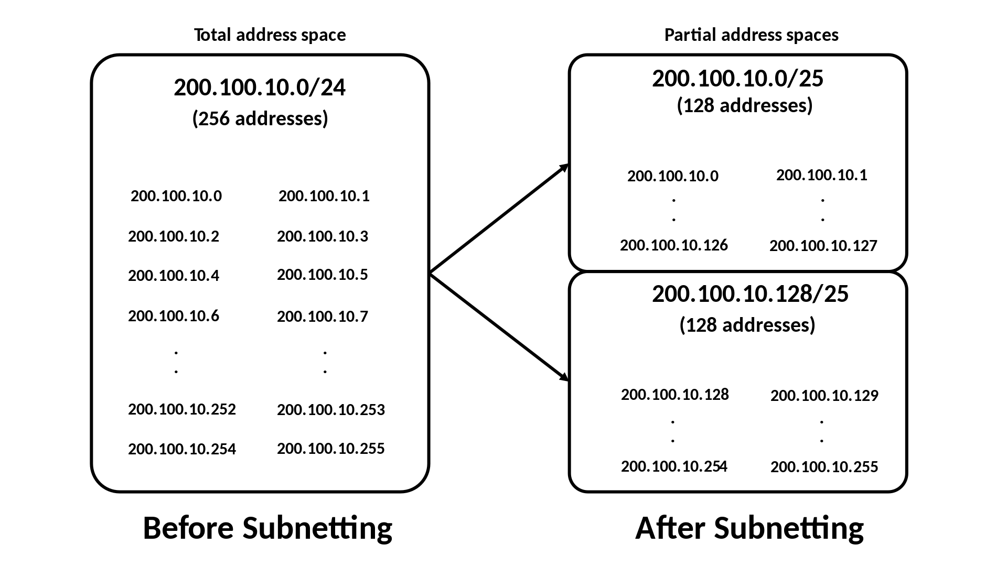
Notes:
Circling back to the home network analogy, if you think about your ISP being a network, then your home network can be considered a subnet of your ISP's network.

Slide 20
Subnet Rules
Subnets must be associated with a Route Table.
A Public subnet has a route to the Internet.
A Private subnet does not have a route to the Internet.
A subnet is located in one specific Availability Zone.

Slide 21
Creating subnets in VPC
CIDR range for the VPC – 10.0.0.0/16 – 65,536 IPs – It is an estimation of total resources in your network.
Subnets | CIDR | Available IPs | Total number of IPs
public-subnet-1a | 10.0.0.0/24 | 10.0.0.0 – 10.0.0.255 | 256
public-subnet-1b | 10.0.1.0/24 | 10.0.1.0 – 10.0.1.255 | 256
public-subnet-1c | 10.0.2.0/24 | 10.0.2.0 – 10.0.2.255 | 256
private-subnet-1a | 10.0.3.0/24 | 10.0.3.0 – 10.0.3.255 | 256
private-subnet-1b | 10.0.4.0/24 | 10.0.4.0 – 10.0.4.255 | 256
private-subnet-1c | 10.0.5.0/24 | 10.0.5.0 – 10.0.5.255 | 256
Note: The first (network) and the last (broadcast) IPs cannot be used. When you create resources on AWS, some of them implicitly gets an IP from the subnet.
Notes:
a CIDR block of 192.0.128.0/21 . What this means is that the first 21 bits of the 32 bits that form the IP address are part of the network. The remaining bits (11 ) are for the IP addresses in the VPC.

Slide 22
VPC Security Layers
The VPC has two layers of security:
Security Groups (SG) can be allowed to modify permission any resource that it is attached to. (Instance level)
Network Access Control Lists (NACL) are applicable for the whole subnet that they are attached to. (Subnet level)
NACLs are stateless so the rules for inbound and outbound traffic are separate while SG is stateful.

Slide 23

Network Access Control Lists - NACL
Acts as a firewall between subnets. A network access control list (NACL) is an optional layer of security for your VPC that acts as a firewall for controlling traffic in and out of one or more subnets.
Your default VPC already has an NACL in place and associated with all default subnets.
In N. Virginia region, we have 6 AZs, AWS created a subnet replicated in all AZs.
Read more about Network ACLs
Notes:
Firewall or Subnet Security layer

Slide 24
Network Access Control List - NACL
Route Table
The default NACL allows all traffic, both inbound and outbound
EC2
EC2
Subnet 1 (public)
Subnet 2 (public)

Slide 25
NACL Rules
Rules are evaluated from lowest to highest based on rule #.
The first rule found that applies to the traffic type is immediately applied, regardless of any rules that come after it.
A subnet can only be associated with one NACL at a time.
A NACL allows or denies traffic from entering a subnet. Once inside the subnet, other AWS resources may have additional security layers (security groups).

Slide 26

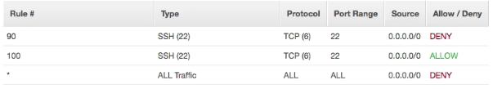
NACL Rules
The default NACL allows all traffic to the default subnets.
Any new NACL you create denies all traffic by default.
Inbound
All traffic is allowed
Inbound
All traffic is denied

Slide 27

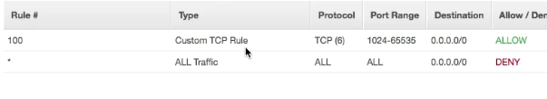
Only Allow SSH
Inbound
Only allow SSH
Outbound
Allow SSH response

Slide 28
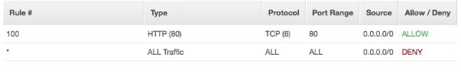
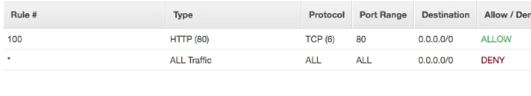
Only Allow HTTP
Inbound
Only allow HTTP
Outbound
Allow HTTP response
Notes
The outbound traffic will use ephemeral ports 1024-65535 for the return web traffic and not port 80.
An ephemeral port is a short-lived transport protocol port for Internet Protocol (IP) communications.

Slide 29
Network Access Control List - NACL
Internet Gateway - IGW
Route Table with IGW
Route Table without IGW
Route Table 1
Route Table 2
Private Subnet does not have a route to the Internet
Public Subnet have a route to the Internet
EC2
EC2
Subnet 1
Subnet 2

Slide 30
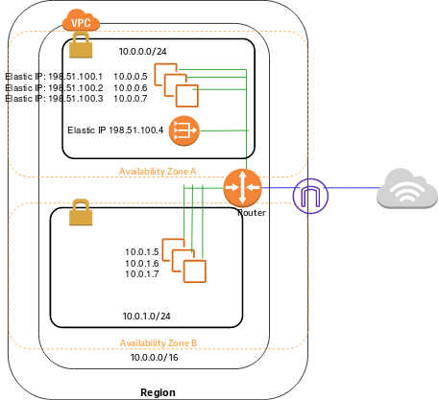
NAT gateways
You can use a network address translation (NAT) gateway to enable instances in a private subnet to connect to the internet or other AWS services, but prevent the internet from initiating a connection with those instances.

Slide 31
NAT gateways
We need to create a custom Route Table for private subnets.
Destination | Target
10.0.0.0/16 | local
0.0.0.0/0 | nat-gateway-id
Keep the main table as below. We must create the NAT gateway in public subnet.
Destination | Target
10.0.0.0/16 | local
0.0.0.0/0 | internet-gateway-id

Slide 32
Network Access Control List - NACL
Internet Gateway - IGW
Availability Zone 1
Availability Zone 2
Route Table
Primary Webserver
Backup Webserver
Subnet 1 (public)
Subnet 3 (public)
Primary RDS
Backup RDS
Subnet 2 (private)
Subnet 4 (private)

Slide 33
Network Access Control List - NACL
x
Internet Gateway - IGW
Availability Zone 1
Availability Zone 2
x
Route Table
x
x
x
Primary Webserver
Backup Webserver
Subnet 1 (public)
Subnet 3 (public)
x
Primary RDS
Secondary RDS
Subnet 2 (private)
Subnet 4 (private)

